Slide 1
Business Analysis
Using SQL AND PYTHON

Slide 2
The dataset involved in this project focuses on Target(Company name) operations in Brazil, covering 100,000 orders placed between 2016 and 2018. It includes detailed information on order status, pricing, payment and shipping performance, locations, and product attributes.
Before starting the work on this project we first connected MY SQL with Jupyter notebook

Slide 3
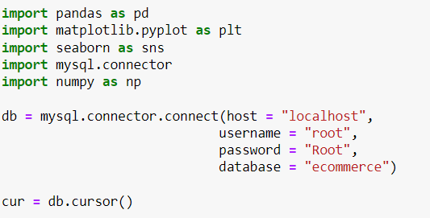

Slide 4
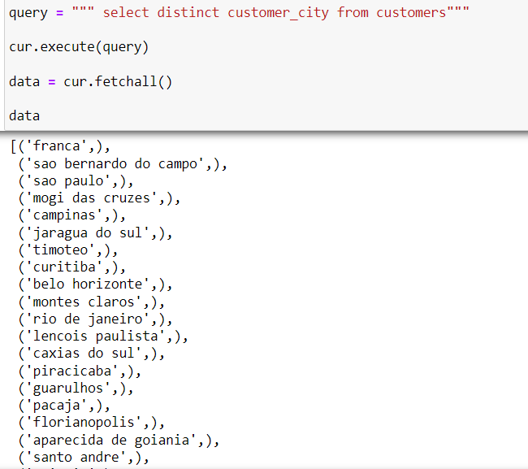
we First check out the unique cities where Customers are located

Slide 5
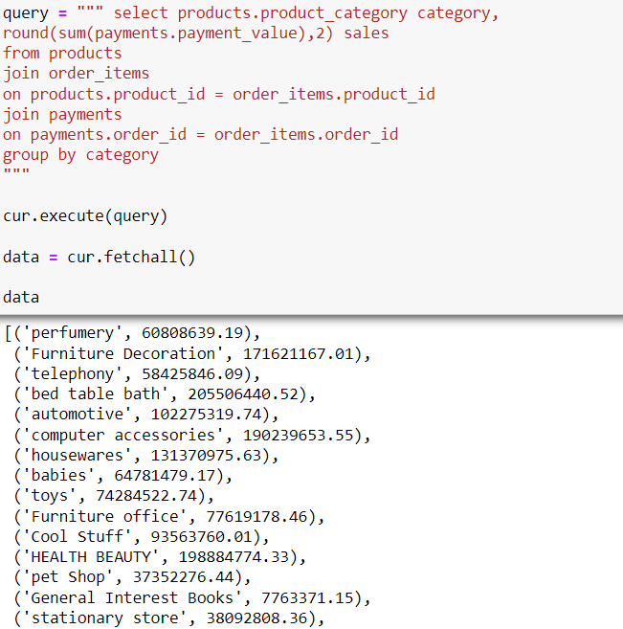
Now THE TOTAL SALES WE HAVE PER CATEGORY

Slide 6
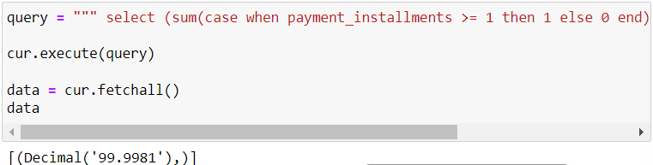
After that we are calculating the percentage of orders that were paid in installments

Slide 7
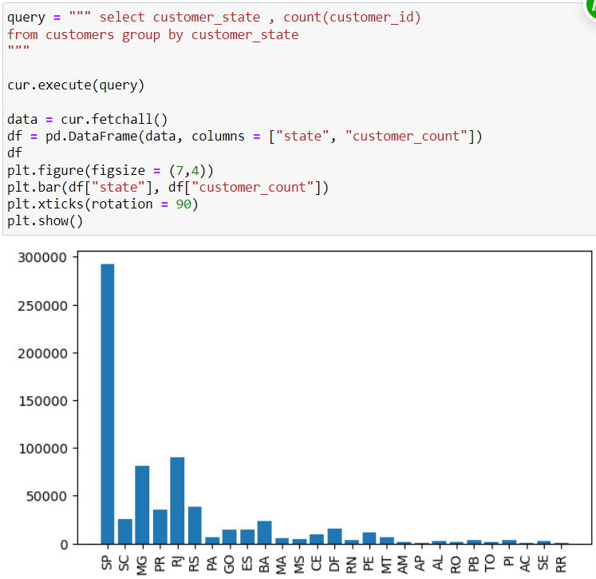
The number of customers from each state

Slide 8
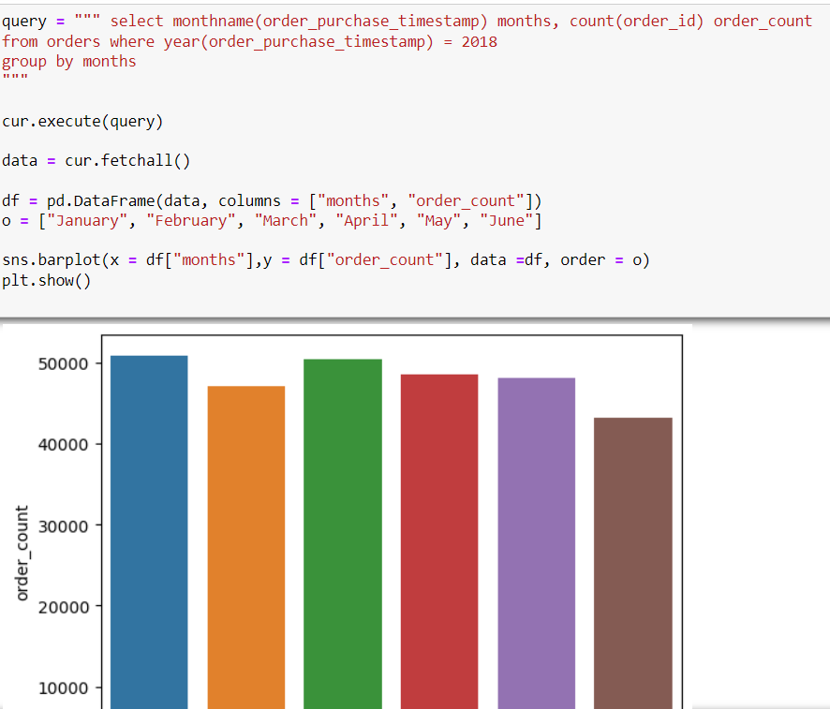
Now we will particularly check the number of orders per months in 2018

Slide 9
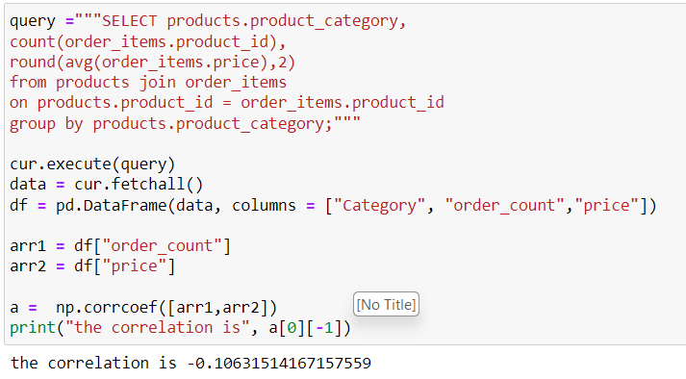
Here we will try to find the correlation between product price and the number of times a product has been purchased

Slide 10
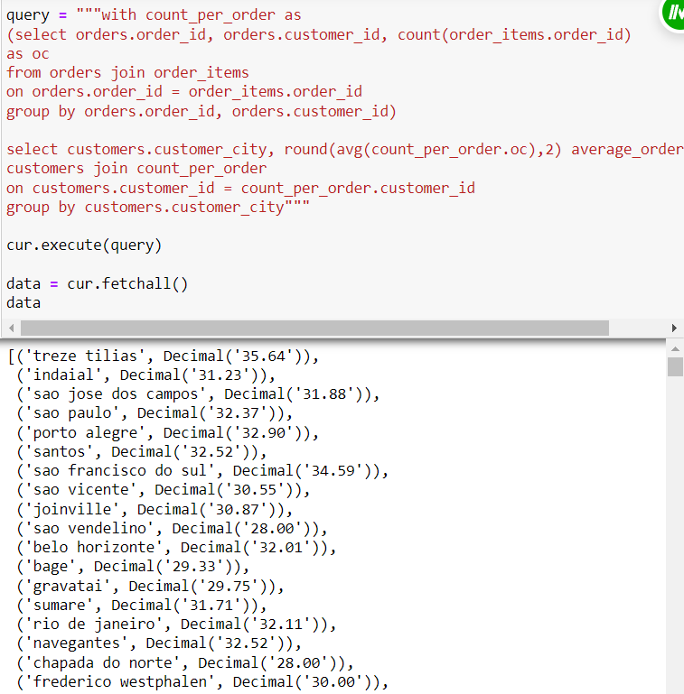
The average number of products per order, grouped by customer city

Slide 11
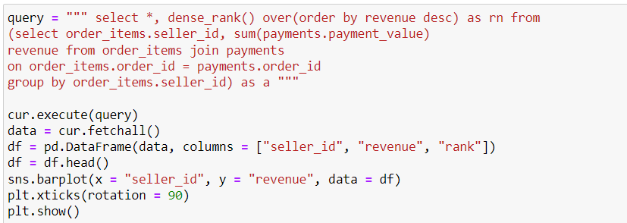
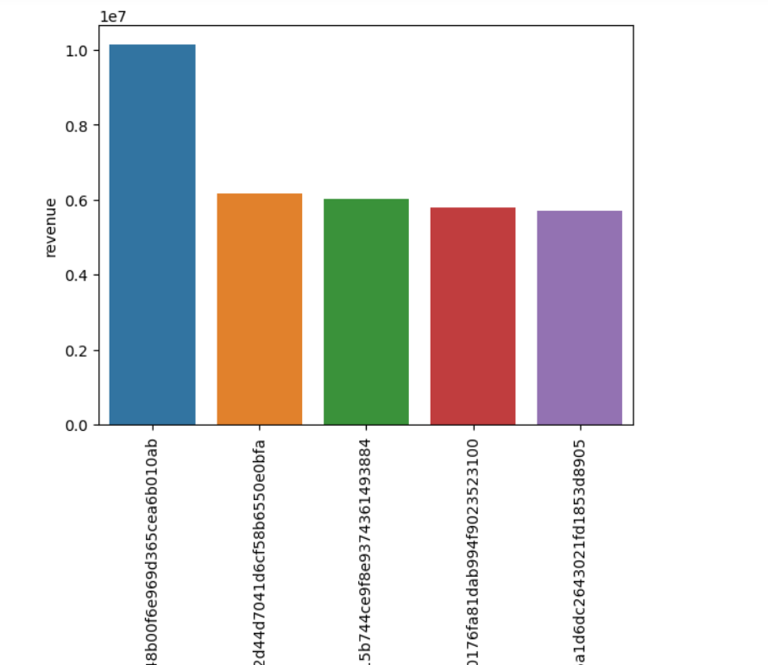
The total revenue generated by each seller and their rank

Slide 12
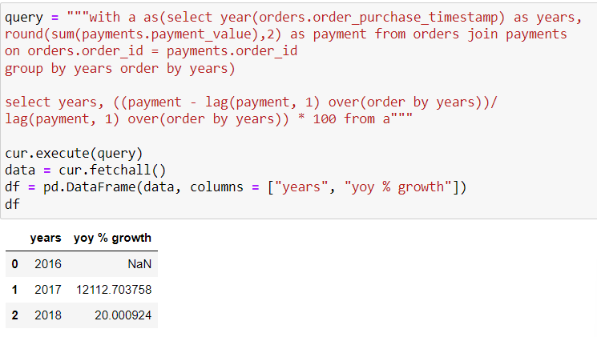
Finally the year over year growth rate of total sales

Slide 13
Some Findings and Conclusion
We found that 99.99 percent of orders were paid in installments
The state of Sau Paulo has the highest no.of customers
In the year 2018, the highest number of orders we got was in the month of January
The correlation between product price and number of times a product has been purchased is -0.10 which means there is a weak correlation between them
The highest revenue is generated by seller id – 7c67…
The year-over-year growth was highest in 2017

